Slide 1
Responsive Design, Troubleshooting, & Media Queries
Front-End Web Development

Slide 2
Lesson 12 Change Log FEWD 3.1 - 3.2
Below are the specific changes made in this lesson.
Returning Instructor Directions:
Click on the hyperlinks below, and it will direct you to the specific slide.
Copy the entire slide, and paste in your existing curriculum deck.
Pre-Class Materials and Preparation -
Added warmup activities to the new CodePen collection “Warmups”.
Added three new Codepens to — Animations Demo, Translated Box, Transitions Demo — Reference Code.
Added new CodePen — Background Color Animation — to Starter and Solution Code.
Share how the lesson went through our Instructor Lesson Exit Ticket - the Curriculum Feedback form: http://ga.co/curriculum-feedback

Slide 3
Pre-Class Materials and Preparation
Review all slides, lab activities, and code-alongs.
There are prompts in the speaker notes with opportunities for instructor customization.
Materials:
Reference Code
Starter Code in CodePen
Solution Code in CodePen
Warmups in CodePen

Slide 4
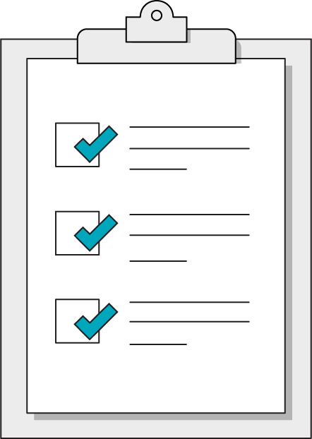
Today’s Learning Objectives
In this lesson, you will:
Review responsive design through troubleshooting
Use media queries to create print-friendly layouts
Use JavaScript to trigger CSS animations.
‹#› | © 2020 General Assembly
Notes:
DURATION: 1 minute
TEACHING TIPS:
Learning objectives help frame the lesson and give students an idea of what to expect and focus on.
Explain to students how this lesson fits into the overall course to help them make connections with content from other lessons.

Slide 5
Troubleshooting
Front-End Web Development

Slide 6
The Bad Intern Plays Chicken
60 Minutes
The bad intern has been given another chance and has blown it! The client is a large e-commerce company specializing in agricultural products and your firm has designed a new product page. Fix the intern’s mistakes!
Starter code:
https://drive.google.com/drive/folders/1_NewAC9XrQxWxt47fAKccetf5pRUdSkI?usp=sharing
Solution code:
https://drive.google.com/drive/folders/1xCDNN_7NP2hNR2J243JfHEe_vZ5zQhIH?usp=sharing
‹#› | © 2020 General Assembly

Slide 7
Media Queries Again
Front-End Web Development

Slide 8
The Media Query
.text-design {
font-size: 18px;
}
@media (min-width: 480px) {
.text-design {
font-size: 24px;
}
}
Target a min-width with @media and provide property/value pairs inside of the current style sheet. The code really is this easy but there’s more to consider.
Notes:
Source: W3School: @media Rule
TEACHING TIPS:
As you walk through this, you might have to draw out some different example devices and outputs on the whiteboard.
A good example to view in DevTools is the H1 on the https://generalassemb.ly/ site, as it alternates between 2.4rems (min-width:720px) and 2.5rems (mobile).
TALKING POINTS:
Sites such as http://ami.responsivedesign.is/ are used to test the responsive design implemented by any site accessible via the web.

Slide 9
Media Types
Typically, all you would use is the screen type. Many sites leave it out altogether now.
Media Type | Description
all | Suitable for all devices
print | Styles for printed documents
screen | Phones, tablets, TV, watches, computers
speech | Screen readers for accessibility
Notes:
TEACHING TIPS:
Students almost never struggle with this. I’d just comment that most people leave out type now, because everything registers as a screen. (Although speech was just added; it might be interesting to show some accessible examples, if anyone knows of one.)

Slide 10
Media Features (abridged)
There are a handful of targetable features that we regularly use. There are a lot more that are almost never used.
Media Type | Description
width | Suitable for all devices
height | Styles for printed documents
orientation | Phones, tablets, TV, watches, computers
Notes:
TEACHING TIPS:
Students almost never struggle with this. I’d just comment that most people leave out type now, because everything registers as a screen. (Although speech was just added; it might be interesting to show some accessible examples, if anyone knows of one.)

Slide 11
The Printed Word
60 Minutes
CSS is not just for screen display. This invoice for an e-commerce website needs to be tuned for print. Eliminate all unnecessary page elements and re-tune the page to print.
Starter code:
https://drive.google.com/drive/folders/1wQv2aYGyfmDT65LuCKHRzoIYeCNVgaXc?usp=sharing
Solution code:
https://drive.google.com/drive/folders/1umaaRgfHwvKU7Ftle0WhoKyh3glDZjBa?usp=sharing
‹#› | © 2020 General Assembly

Slide 12
Enrichment: Animation
Front-End Web Development

Slide 13
Three Types of Animation
We’re going to cover three animation techniques in this lesson:
Simple: transition property with the :hover pseudo-class.
Changes the background color of a button when the user hovers over it.
Less Simple: animation property with the @keyframes rule.
Moves an element on the page with animation.
JavaScript: Switch application state with .classList.toggle().
Triggers an off-canvas menu to appear or disappear.

Slide 14
Simple Animation
The easiest way to animate something in CSS is by using the transition property in conjunction with the :hover pseudo-class. This method includes:
The CSS property to be animated.
The time duration of the animation.
The type of animation to be used.

Slide 15
Transition Tips
The transition property is assigned to the off (initial) state of your component.
Typically, you can leave out the specific thing changing and just use something like transition: 0.4s ease-in-out;. If you’re sure you only want one specific property to transition, however, it’s safest to be specific and leave it in.
Animating multiple properties at once can be a bit much for you and for users, so go easy with this stuff!

Slide 16
Transition Example
Start
End
>
.button {
background-color: red;
transition: background-color 0.4s ease-in-out;
}
.button:hover {
background-color: orange;
}
Notes:
TALKING POINTS:
Transitions can also occur on elements nested within the button as the element itself and are often used for overlays: https://codepen.io/jkeohan/pen/rgYddb
Another use case is an animated hamburger menu: https://codepen.io/jkeohan/pen/eaerJY

Slide 17
HTML for Animation
List interactive components as close to the DOM tree root as possible.
This improves code organization and creates slightly cleaner HTML.
Pages perform better if the browser doesn’t have to drill through the DOM.
Animated elements are a perfect use case for the <aside> tag.
<body>
<main class=“my-content”>
</main>
<aside class=“ui-tabs”>
<!—- Interactive stuff —>
</aside>
</body>
Notes:
TALKING POINTS:
The <aside> tag generally notes non-linear content and, as popups/modals and such are animated in and out of the regular content flow, they are semantically “aside” from the regular content.

Slide 18
Hiding Content
Keep your HTML block turned off with CSS. There are four methods with which to hide elements in CSS, each with slightly different results.
Property | Takes Up Space | Can Be Clicked
display: none; | No | No
visibility: hidden; | Yes | No
opacity: 0; | Yes | Yes
background: rgba(0,0,0,0) | Yes | Yes
Notes:
Source: https://stackoverflow.com/questions/14731049/visibilityhidden-vs-displaynone-vs-opacity0/34529598#34529598
TEACHING TIPS:
You might want to show them the Stack Overflow source of this table as a lesson in researching different options for doing the same thing. You can read documentation but often you can google the question you have, find a SO, and read through it for sensible answers and upvotes.

Slide 19
Keyframes and Animation
Front-End Web Development

Slide 20
Animations References
CSS transition, transform, animation, and @keyframes examples galore!
Reference code:
https://codepen.io/GAmarketing/pen/abzpjMG
‹#› | © 2020 General Assembly

Slide 21
Less Simple Animation
Complex animations require multiple steps. For these, you’ll need to use CSS animation and @keyframes together. This will allow components to move in more interesting ways than simply appearing and disappearing!
Here’s what it takes:
Outline animation steps and timing.
Set each movement instruction of a @keyframes step (usually a transform).
Use CSS animation properties and apply everything to the component’s initial state.

Slide 22
CSS @keyframes
@keyframes work like media queries — conditional-based instructions that happen at particular times. Notice that we’re giving this a custom name, mover.
@keyframes mover {
0% {
transform: translateX(0) translateY(0);
}
50% {
transform: translateX(300px) translateY(0);
}
100% {
transform: translateX(300px) translateY(300px);
}
}

Slide 23
CSS Animation
The property contains a bunch of settings, similar to how background works.
.box {
animation-name: mover;
animation-duration: 2s;
animation-timing-function: ease-in-out;
animation-direction: alternate;
animation-iteration-count: infinite;
}
OR
.box {
animation: mover 2s ease-in-out alternate infinite;
}
Notes:
TALKING POINTS:
You can either define each property individually or do it all in one shorthand statement. It can be tricky to remember the order of the properties in the shorthand version, but keep in mind that all of this knowledge is a short Google search away once you know the concept!

Slide 24

CSS Transforms
You can also adjust the shape and position of elements with transform. It’s not required to do animation, but it is the easiest way to move things fluidly.
You can do a lot with transform — CSS Tricks has great documentation, as usual!

Slide 25

Storyboard Keyframes
Complex animations require something akin to pseudocode before digging in.
Step 1 (0%):
Box top, left
Step 2 (50%):
Box top, right
Step 3 (100%):
Box bottom, right

Slide 26
Animations Practice
30 minutes
With a partner, practice applying these CSS properties in this CodePen.
Starter code:
https://drive.google.com/drive/folders/1qBCQDTRO19yhwyQ7KKJPaZXGjIuKpcFD?usp=sharing
Solution code:
https://drive.google.com/drive/folders/1F_wy4smd29cLW2bcMw4Gnd221kr0ImR8?usp=sharing
‹#› | © 2020 General Assembly

Slide 27
Stateful Applications
Front-End Web Development

Slide 28
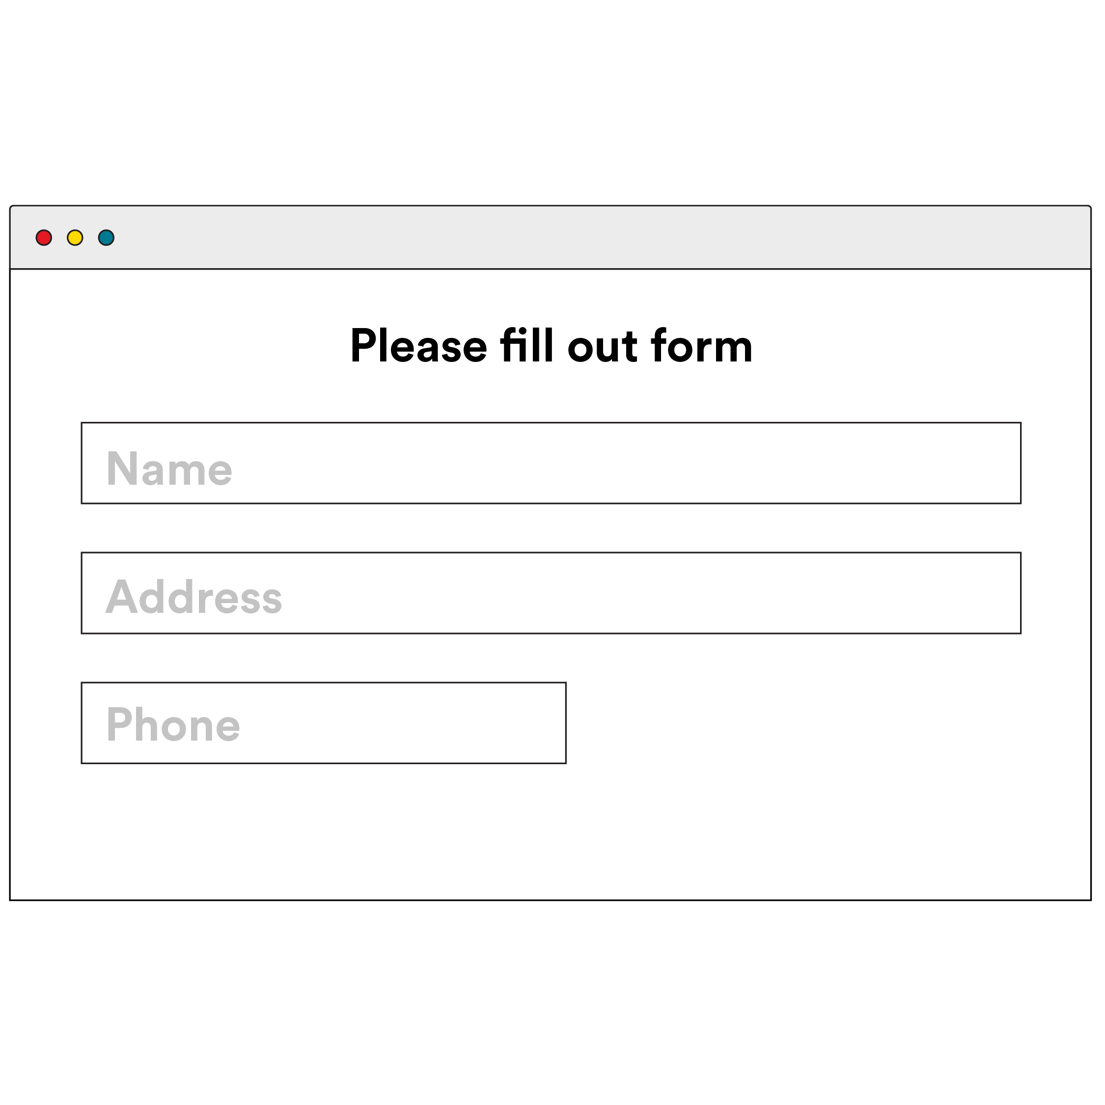
Stateful Apps
Interactive components subtly introduce a huge idea: state. State can include anything the user might toggle or adjust in your site, such as:
Showing or hiding menus, forms, or modal windows.
Filtering, adding, or removing the data displayed on a page.
Filling out form inputs.
Notes:
TALKING POINTS:
In the most dynamic applications, the front-end is really just a projection of the application state, giving the user enough interface to read and modify the data powering the application. State is the truth behind an application, and the UI is a representation of that truth.
TEACHING TIPS:
Feel free to get philosophical about this.

Slide 29
How to Build Components
Building actual components means taking everything you know and putting it together. It may seem like a lot at first, but start slow and you’ll get there. Here’s how the steps break down:
Sketch out the two states of your component.
Build the “on” state first without turning it “off.” It will likely sit on top of your other work for now, but that’s OK!
Finally, add in the special CSS/JS you need to make the magic happen. Do this LAST!

Slide 30
Navigation Menu Toggle
Add the necessary JavaScript to this CodePen so that the hamburger icon opens a navigation menu and the “Close This” menu item closes it again.
Explore the CSS as another reference for animations!
Starter code:
https://codepen.io/GAmarketing/pen/YzPNOZK
Solution code:
https://codepen.io/GAmarketing/pen/mdyRGmJ
‹#› | © 2020 General Assembly

Slide 32
Advanced Animation Resources
Charts.js: good enough charts/graphs
D3: a popular data visualization tool
GSAP: a keyframe animation toolkit

